Slide 1
APSG 43: THE IMPACT OF AUTOMATION ON THE GEODETIC WORKFLOW
WELCOME
Chris Echols
APSG Chair

Slide 2
SAFETY BRIEFING
We hope APSG members, their families, and the community at large are staying healthy during the spread of coronavirus (COVID-19).
As areas slowly begin to relax social distancing restrictions, a few reminders for keeping everyone safe:
Stay home if you’re not feeling well.
Keep your distance.
Please wear PPE in crowded areas.

Slide 3
APSG OVERVIEW
Association of Petroleum Surveying & Geomatics (APSG)
Tax Exempt Non-Profit Professional Organization
Founded in 1998 – 22 years and still going!
Membership & Mission
Follow Along:
Facebook - https://www.facebook.com/APSGinfo
LinkedIn NPO – https://www.linkedin.com/company/association-of-petroleum-surveying-and-geomatics-apsg
LinkedIn Group* – Association of Petroleum Surveying and Geomatics (APSG) https://www.linkedin.com/groups/12298277/

Slide 4
MEET OUR COMMITTEES
APSG events are organized by…
APSG Chair | Chris Echols, Oceaneering
Vice Chair | Aidan Thirsk, Zupt LLC
Treasurer | Ryan Brown, OARS LLC – Treasurer
Communications Chair | Jennifer Still, Integrated Informatics Inc
Education Chair | Stacey Lyle, Texas A&M University
Join us!
Membership Chair position available. Contact chair@apsg.info
Need candidate(s) for Vice Chair come elections at the APSG 44 Fall Meeting

Slide 5
APSG 43: OUR 1ST DIGITAL MEETING
You asked – we listened
The (unexpected) digital transformation - Zoom!
The future format

Slide 6
MEMBERSHIP UPDATES
Current Status & Rates of APSG Memberships (as of May 7, 2020)
MEMBERSHIP TYPE | TOTAL NO. OF MEMBERS
5 YEAR | 31
ANNUAL | 467
LIFETIME | 77
STUDENT | 86
TOTAL | 661

Slide 7
ORGANIZATION UPDATES
Division of industries represented by APSG members…
MEMBERSHIP TYPE | MEMBERSHIP RATE
5 YEAR | $275
ANNUAL | $60
LIFETIME | $1200
STUDENT | Free

Slide 8
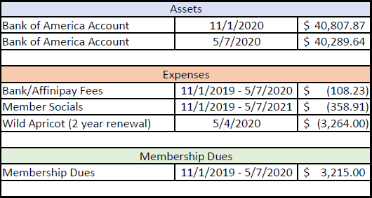
FINANCIAL UPDATES

Slide 9
ORGANIZATION UPDATES
Texas A&M Student Chapter
MTS BBQ
Social attendance increased!

Slide 10
For each talk…
Leave your questions in the COMMENTS.
Answer any poll questions provided by the speaker.

